Slide 1
GES SpED Digital Literacy Workshop
Wednesday February 24th – Friday February 26th
Presented by Blue Sea Consulting
in partnership with CHIP International

Slide 2
Blue Sea Consulting Contact Details
Tel: 0249230792
Please send a WhatsApp message “Digital Learning” and your full name to number above
A WhatsApp group “Digital Learning” has been created
You will be added to group as soon as your WhatsApp message is received.

Slide 3
Course Schedule
Day 1 –Internet background, Internet Service Providers and bundles
Day 2 – Video Conferencing, Zoom
Day 3 – Video Conferencing, Zoom (contd)

Slide 4
Digital Literacy and Virtual Know How
The Internet is an increasingly important part of:
Education and Remote Learning
Business processing
Government processing and Information
Religious services and Information
Everyday life
Discuss
Basics of Internet
Internet Service Providers
Video Conferencing
Zoom

Slide 5
Education and Remote Learning
Prior to 2020 move to remote learning
To reach a wider audience
In 2020 COVID-19 remote learning increased
Convenience, flexibility and reach
Remote learning here to stay
Challenges
Access to data bundles
Training for educators

Slide 6
Basics of the Digital World - Internet
The Internet is a global network of billions of computers
The Internet makes it possible to access information, communicate with others, and do transactions
Connecting a computer or mobile device to internet is termed “going online”
World Wide Web called the Web is a collection of different Websites
A Website is made up of text, images and other resources hosted on a server

Slide 7
Internet Service Providers (ISP)
Internet is accessed using a computer or mobile device
Access to Internet is through an Internet Service Provider (ISP)
Internet Service Provider charges a fee for data used or subscription based
Telecom Companies provide data bundles for purchase
Data bundles can be limited by time or data used
Examples of Internet Service Providers are:
MTN
Vodafone
Airtel
Surfline

Slide 8
MTN Bundles
Code *138# - Buy data, Midnight bundle, Kokoroo Special, Media, More
609MB (0.60) – GHS5
980MB (0.98GB) – GHS10
1.6GB – GHS20
2.44GB – GHS30
4.7GB – GHS50
10.73GB – GHS100
16.1GB – GHS150
36.17GB – GHS200… up to 216.47GB for GHS399
Super Saver Bundle for voice and data combos
327.87 MB, 327.87 mins, 100SMS – GHS20
* Prices subject to change

Slide 9
Vodafone Bundles
Code *700# - buy data, check bundles, stop bundle renewal, bundle for someone
1.7GB – GHS10 (valid for 15 days)
4.5GB – GHS20
10.5GB – GHS50
4.7GB – GHS50
10.73GB – GHS100
16.1GB – GHS150
36.17GB – GHS200 …. up to 216.47 GB for GHS399
Code *200# (option 1) - Vodafone Red Bundles for voice and data combos
340MB, 340 mins (all networks), 10 SMS – GHS10
*Prices subject to change

Slide 10
Airtel Bundles
Code *700# - buy data, check bundles
0.25MB – 50p
2.65MB – GHS1
155MB – GHS2
625MB – GHS5
1.6GB – GHS10
43.GB – GHS20
10.4GB –GHS50
*Prices subject to change

Slide 11
Surfline MiFi Bundles (30-days)
1.6GB - GHS10
3.2GB - GHS20
5GB - GHS30
7GB - GHS40
12GB - GHS70
30GB - GHS120
45GB - GHS185
65GB - GHS255…. up to 180GB for GHS305
*Prices subject to change
Ref: https://www.surflinegh.com/personal/data-plans

Slide 12
Common Internet Applications
Internet Applications include:
Email – used to send letters, correspondence, messages to an email address
E.g. John_Smith@TomsSchool.com
Social media – used to communicate with groups and friends
WhatsApp (future presentation), Share photos, video, chat, opinions, group calls, WhatsApp business account, Facebook integration
Education - Google Classroom, Canvas, Blackboard Learn, Schoology
Banking – used to transfer money, pay fees, check balances, buy Momo
Ride Share – Uber, Bolt
Maps – used for turn-by-turn directions, calculate distance/time to destinations

Slide 13
Video Conference Tools
Zoom
WhatsApp
Google Meet
Skype
Microsoft Teams

Slide 14
Using Zoom
Download Application
How to join a Zoom meeting as a Participant
Click link or enter meeting ID
Manage Audio & Video
Audio & Video Properties
Meeting Etiquette
Logging out of a Zoom meeting
How to create a Zoom account
How to Host a Zoom meeting
Managing Q&A

Slide 15
Download Zoom App (Google Playstore or Apple App Store)

Slide 16
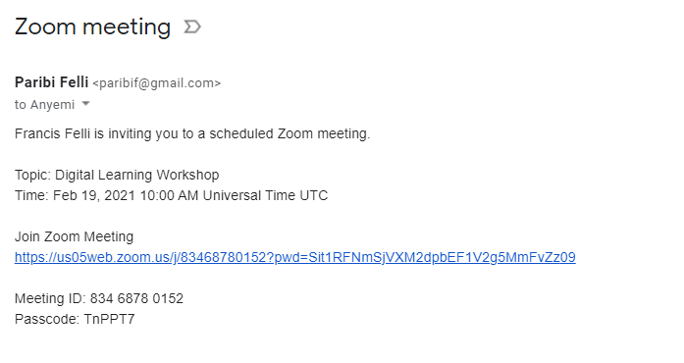
How to Join a Zoom meeting (click link)

Slide 17
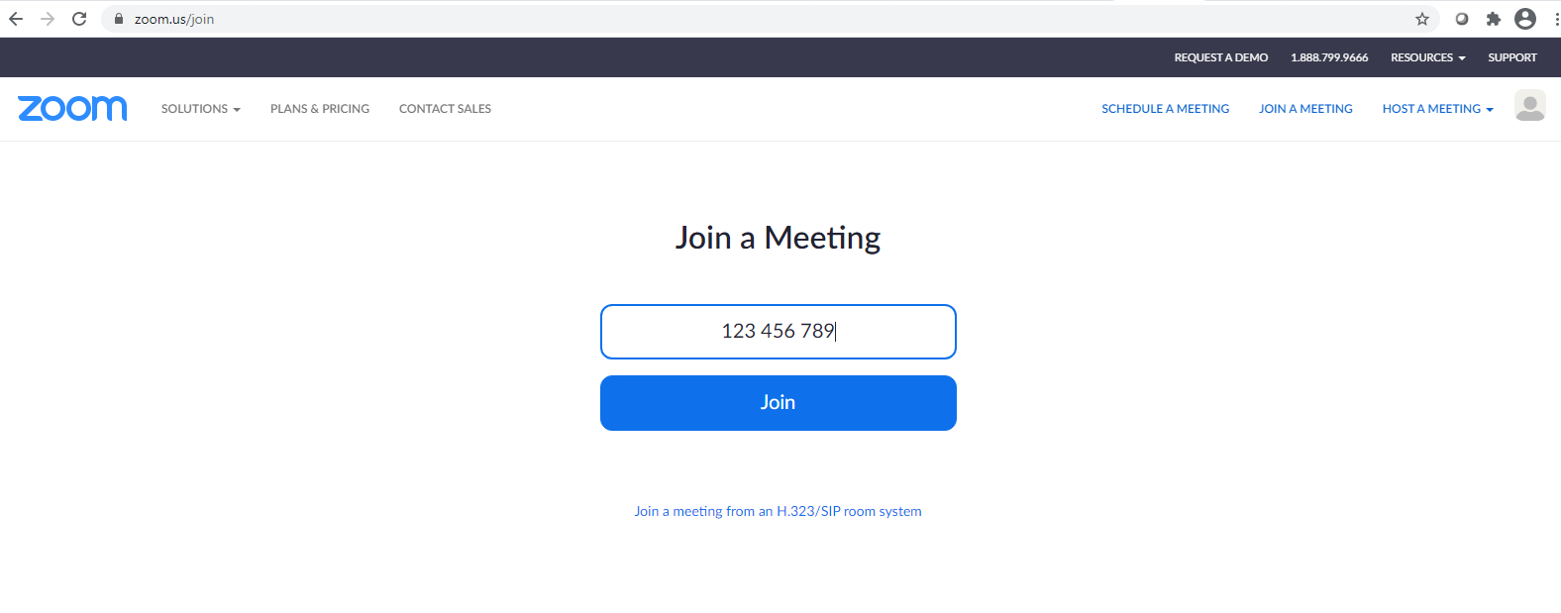
How to Join a Zoom meeting (enter meeting ID)

Slide 18
How to Join a Zoom meeting (tollfree number)
Dial tollfree number
030 708 4860
030 708 4676
Enter meeting ID provided
Enter passcode provided

Slide 19
Manage Audio & Video

Slide 20
Audio & Video Properties

Slide 21
Meeting Etiquette
Don't Be Late
Video meetings make it obvious when colleagues show up late, wasting the time of those who log in promptly
Turn on the Camera
Turn on the Audio
Mute/Unmute as necessary
Sit Still
No Eating
Get Good at Interrupting
Close the Door
Don't Multitask

Slide 22
Logging out of a Zoom meeting

Slide 23
How to create a Zoom account

Slide 24
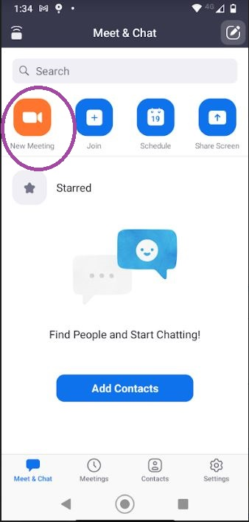
How to Host a Zoom meeting

Slide 25
How to Host a Zoom meeting

Slide 26
Managing Q&A
Set ground rules for Q&A session
Raise hand
Type question in chat session
Be considerate of time constraints
Ask for further reference for in-depth answers

Slide 27
Q&A

Slide 28
THANK YOU!
Blue Sea Consulting
0249230792

